Slide 1
Computational Resources at UW-Madison

Slide 2
Computation in Biology
Biology is often very data heavy
Most biologists aren’t trained in computation/programming (yet)
But most of you will need some of these skills
Your PI/labmates might not be able to help you but…
You don’t have to struggle through this alone!

Slide 3
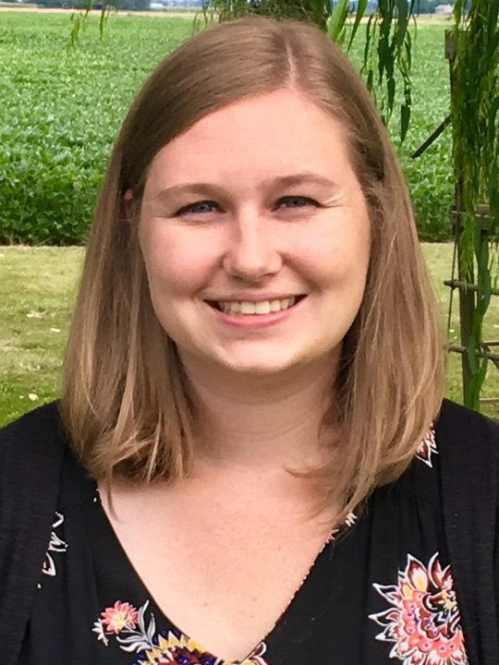
ComBEE
Computational Biology, Ecology, and Evolution Group
Student organized group
Monthly Meetings about Computational Biology or Theoretical Ecology/Evolution
Social gathering Sept. 7th @ 4pm in 6201 MSB
Bi-weekly R/python study groups
https://combee-uw-madison.github.io
Sign up for our listserv to get updates!
Elizabeth McDaniel
MDTP Student
McMahon Lab
Kirsten Gotting
Genetics Student
Currie Lab

Slide 4
ComBEE R/Python Study Groups
These groups meet on opposite weeks
Generally informal discussion of topics
Topics vary decided on based on group interests
Meet on Thursdays at 2pm in MSB 5503
Subject to change, sign up for listserv if you are interested in joining
Python Study Group website
R Study Group website
Sign up for their individual listservs if you are interested

Slide 5
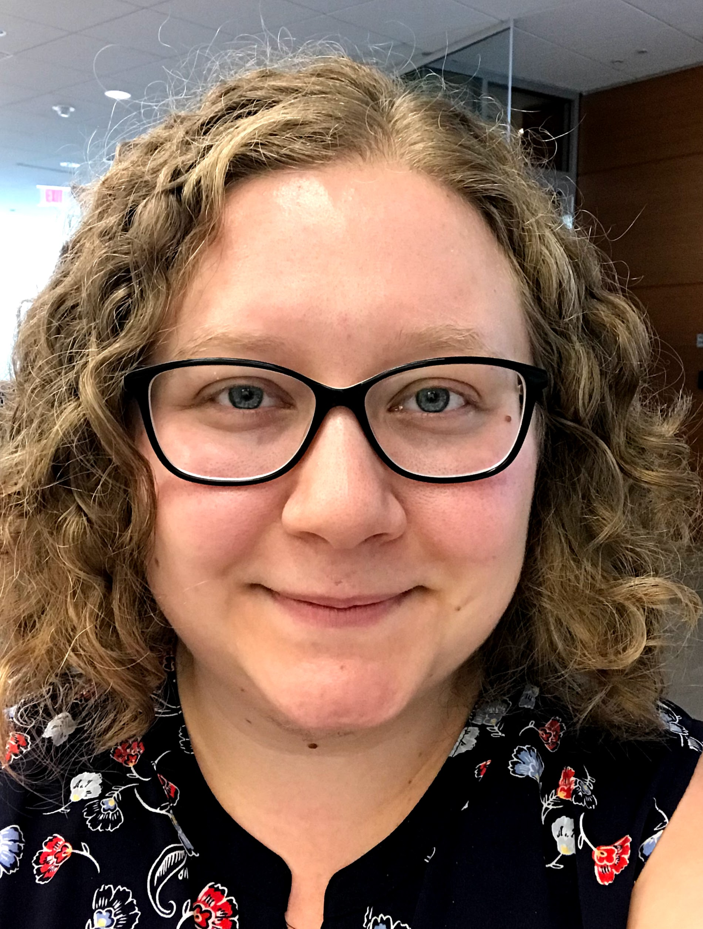
Data Science Hub
What is Data Science?
Data Science: the study, development, or application of methods that reveal new insights from data. [working definition, the field is evolving]
You may apply data science methods in your research
http://datascience.wisc.edu/
First-stop for data science questions
If we can’t help you, we will find someone who can
Hosts data Science training workshops
Building community and facilitating collaborations
Sarah Stevens
Data Science Facilitator
MDTP
Discovery Building

Slide 6


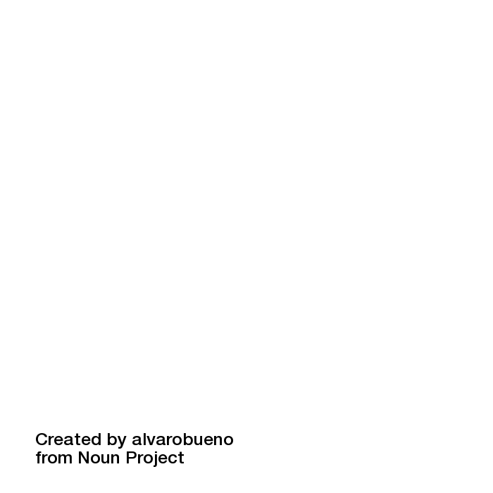





What are Software and Data Carpentry?
One Organization with an international community of volunteers
that develop lessons, train instructors + organize workshops
in data management and software development
best practices
For and by researchers across disciplines
Modified from Christina Koch’s original version

Slide 7
Carpentries on Campus
2 free workshops hosted at beginning of each semester
Next workshops January 2019
SWC: Unix shell, python (or R), and version control (git)
DC: excel, openRefine, SQL, R
Large local community of instructors
If interested you can help out or instruct these workshops
Professional Development/Teaching opportunity
For updates about registration (and other computation/data science events on campus) sign up for Data Science Hub listserv
Send email to join-dshubcommunity@lists.wisc.edu
Notes:
join-dshubcommunity@lists.wisc.edu

Slide 8
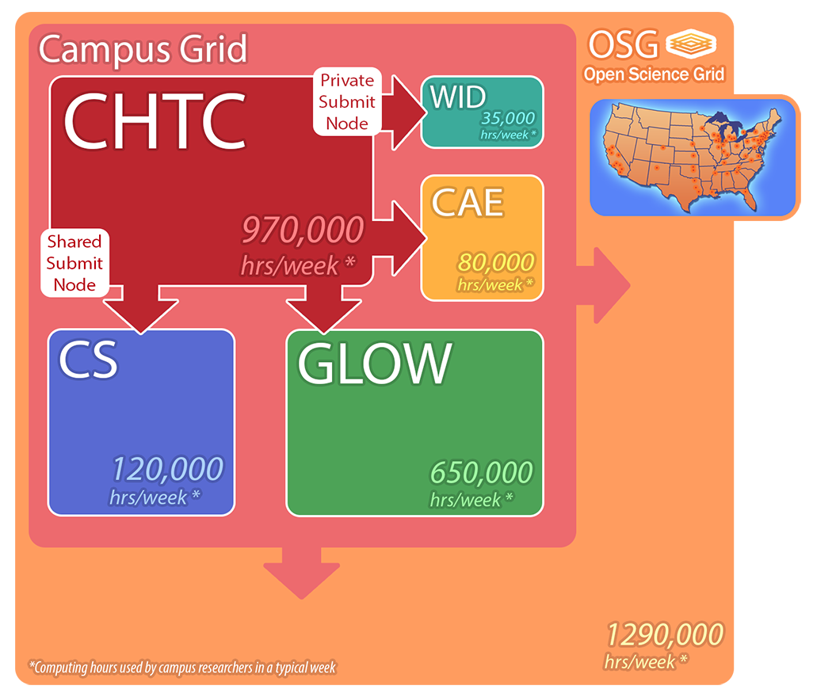
Center for High Throughput Computing (CHTC)
Campus resource
Scale up your computational work
Can run more analyses (and bigger jobs) using their resources
Facilitators who can help you get started

Slide 9
Quantitate Biology Initiative
Initiative to bring together quantitative biology on campus
https://qbi.wisc.edu/
Minor in Quant Bio
https://qbi.wisc.edu/education/phd-minor/
Weekly Seminar Series
https://wid.wisc.edu/seminars/qbio/

Slide 10

Services
Experimental design
Technical consultation
Data analysis
Coordinating collaborative research
Data management
Conducting outreach activities
Developing workshops, teaching modules, seminar series and conferences
Sailendharan Sudakaran
Manager
Email. : madmicrobiome@wid.wisc.edu
Twitter. : @madmicrobiome
Website : microbiome.wisc.edu
Address : Wisconsin Institute for Discovery
Notes:
Madison Microbiome Hub is a joint venture between the UW Biotechnology Center (UWBC) and the Wisconsin Institute for Discovery (WID), making use of current prowess at UWBC in sequencing and bioinformatics and WID’s strength in data storage and management. It will serve as a campus wide resource to support researchers interested in tackling a broad spectrum of microbiome related studies from investigating fundamental questions, developing new techniques and methodologies to understanding the impact of microbiome across different fields. Overall, by harnessing the significant research already taking place at UW, world class expertise and facilities we aim to develop the Madison Microbiome Hub as prominent center for microbiome research at UW.

Slide 11
Other courses
MICROBIO 657: Bioinformatics for Microbiologists
Garret Suen, Spring 2019
STATS 679: Computing Tools for Data Analytics
Cecile Ane, Fall 2018
BMI 541 - Introduction to Biostatistics
BMI 576 - Introduction to Bioinformatics
BMI 776 - Advanced Bioinformatics
CS301 - Introduction to Data Programming

Slide 12
Biotech Center
Biotech Center on campus also offers Bioinformatics workshops (cost $$)
Workshops include:
Linux Basics for NGS Data Analysis
Intro to NGS Data Analysis
Microbiota Processing in mothur
Microbiota Analysis in R
mRNAseq Analysis
Advanced mRNAseq differential gene expression
Single-cell RNA-seq
ChIPseq Workshop
http://www.biotech.wisc.edu/services/brc/workshop

Slide 13
ComBEE
Computational Biology, Ecology, and Evolution Group
Social gathering Sept. 7th @ 4pm in 6201 MSB
Bi-weekly R/python study groups
https://combee-uw-madison.github.io
Sign up for our listserv to get updates!

